Slide 1


Slide 2
From the Kutztown University Faculty Handbook:
Course Guides (First-Day Handouts) - Policy ACA-036
During the first week of classes, faculty members must distribute to their students a written course guide which contains at least the course requirements, attendance policy and the grading procedures, as well as faculty contact information and consultation hours. This information can be distributed separately or as part of such items as course outlines or syllabi and can be provided in print or electronic form. Faculty are encouraged to include the guide in the course D2L shell, regardless of whether it is also distributed on paper or via email. Any subsequent changes to this information must be given to the class in writing.

Slide 3
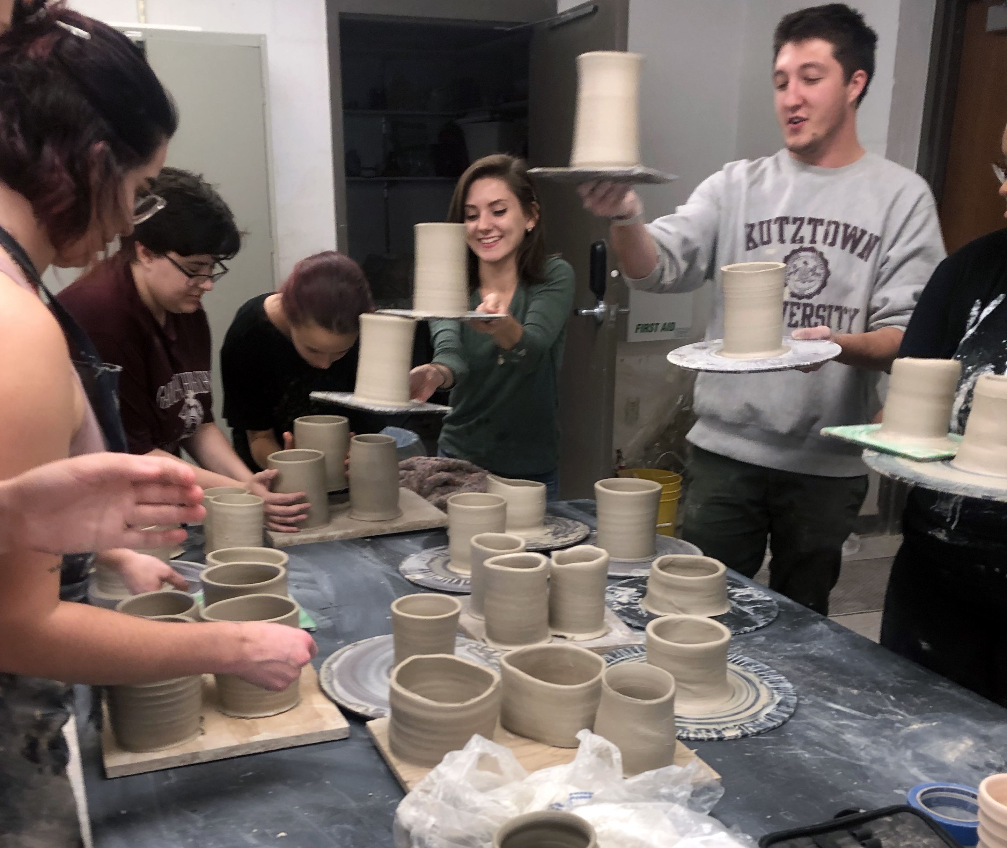
What is a Syllabus?
. . . a road map?
. . . a contract?
. . . an academic paper?
. . . a to do list?
. . . place for you to lay down the laws?
. . . an invitation?
. . . a marketing opportunity?
What do students really want to know on the first day of class?

Slide 4
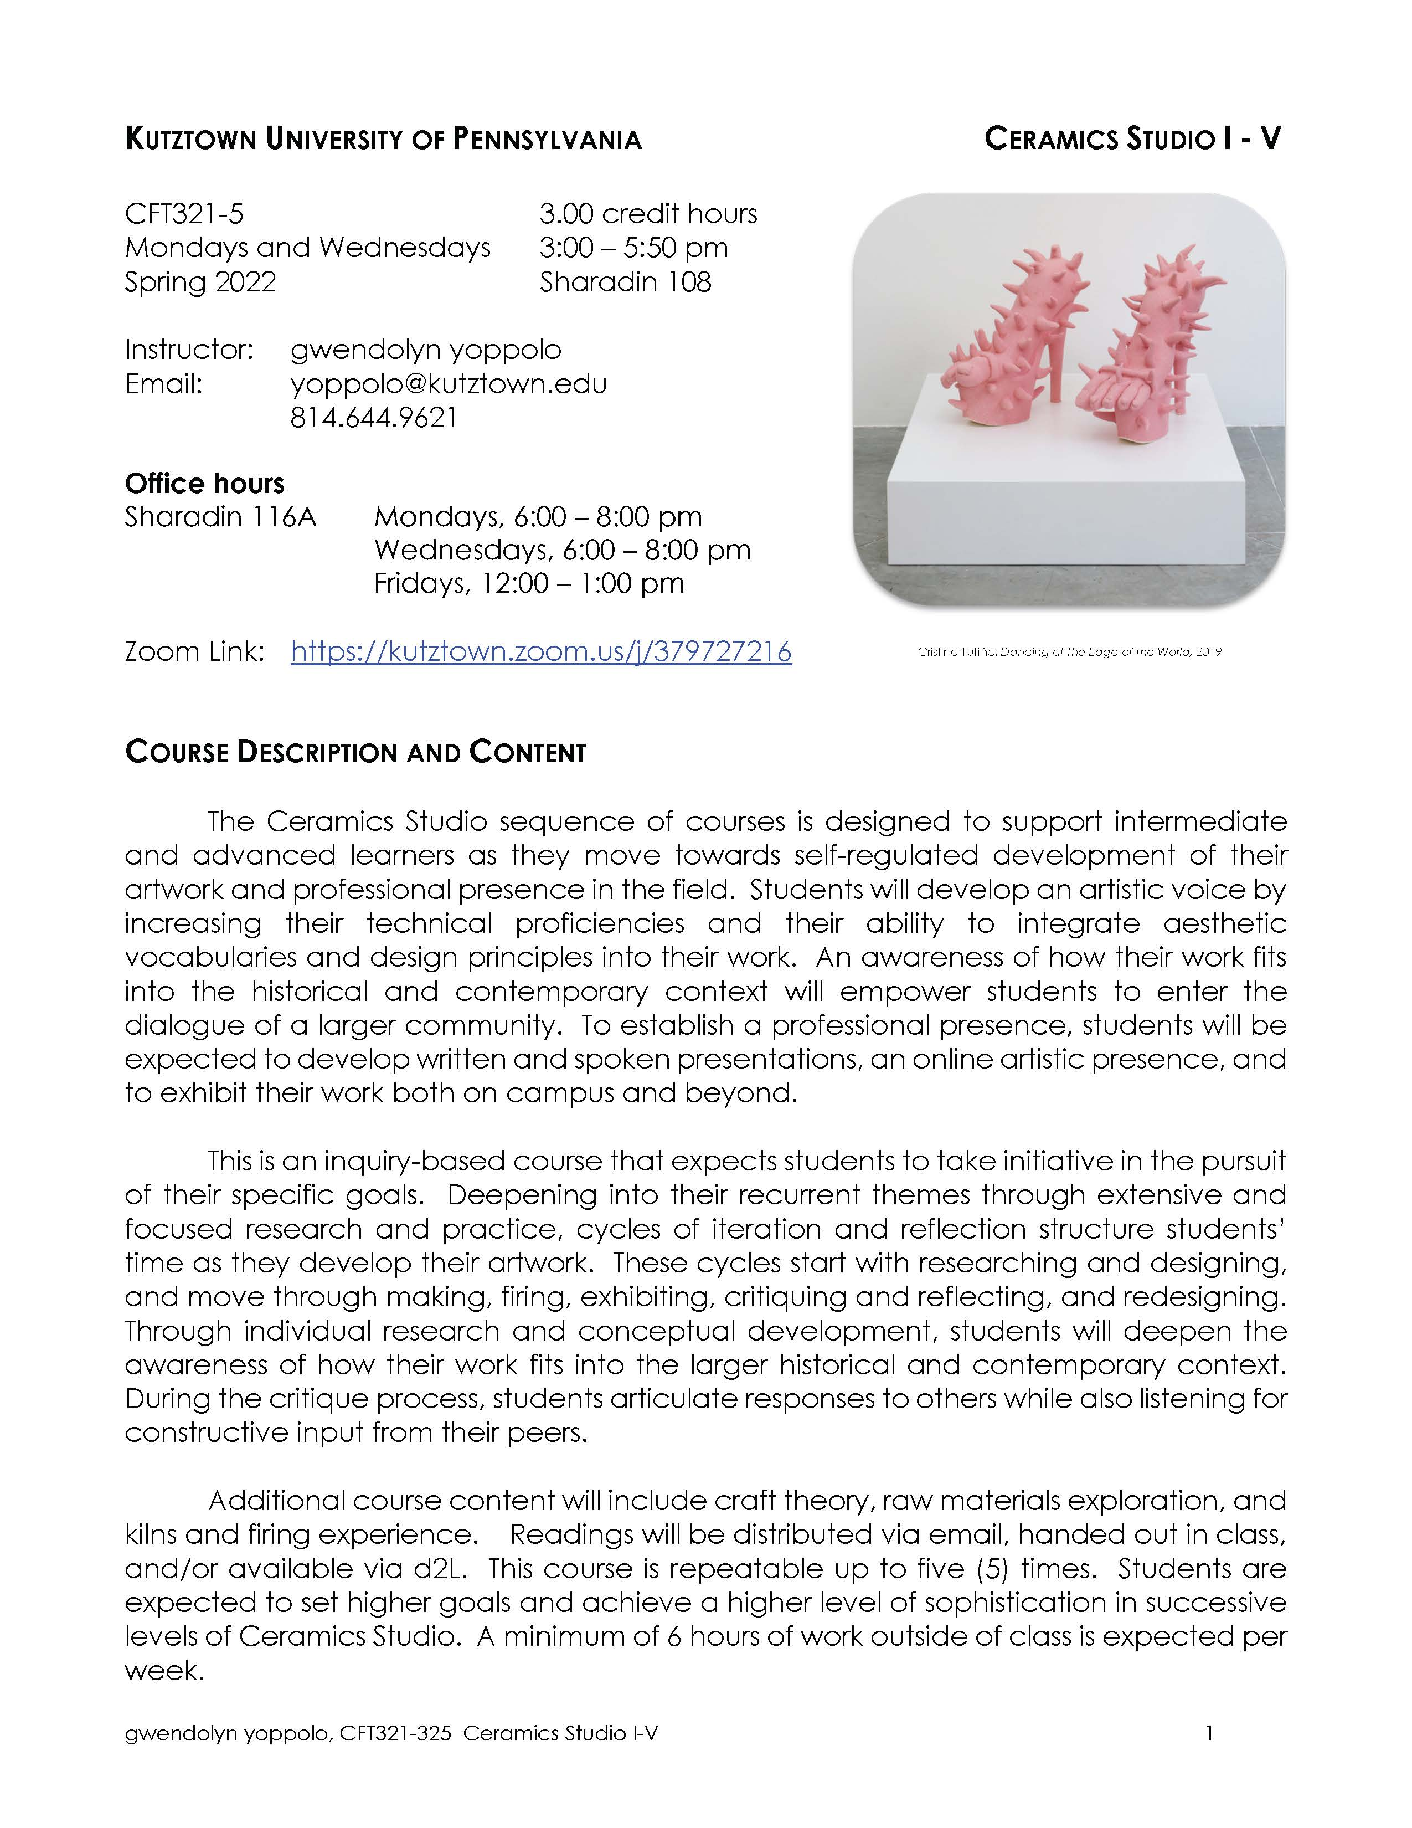
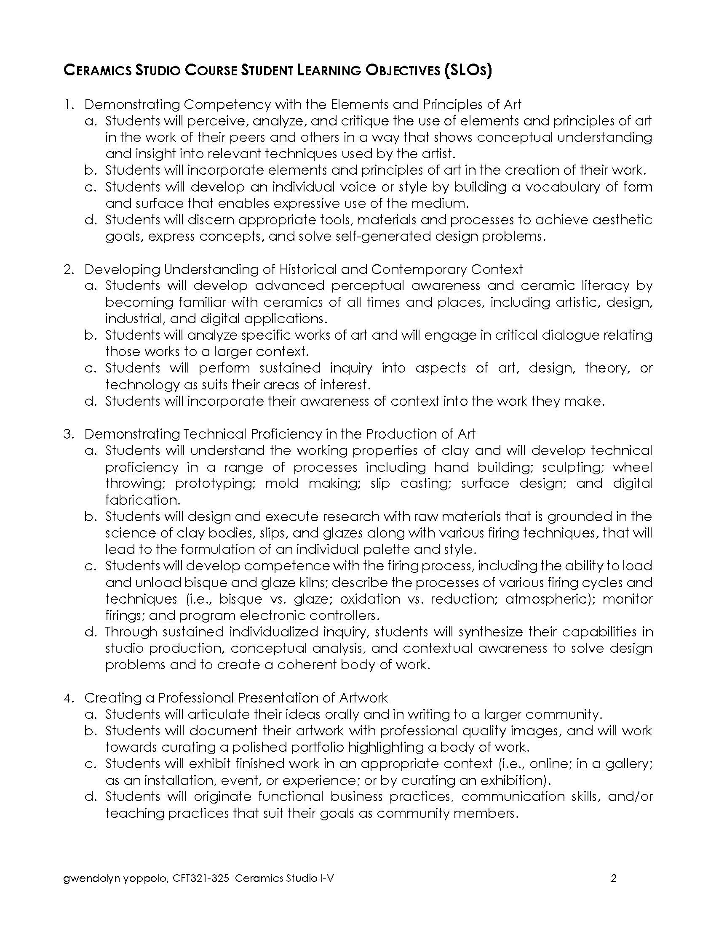
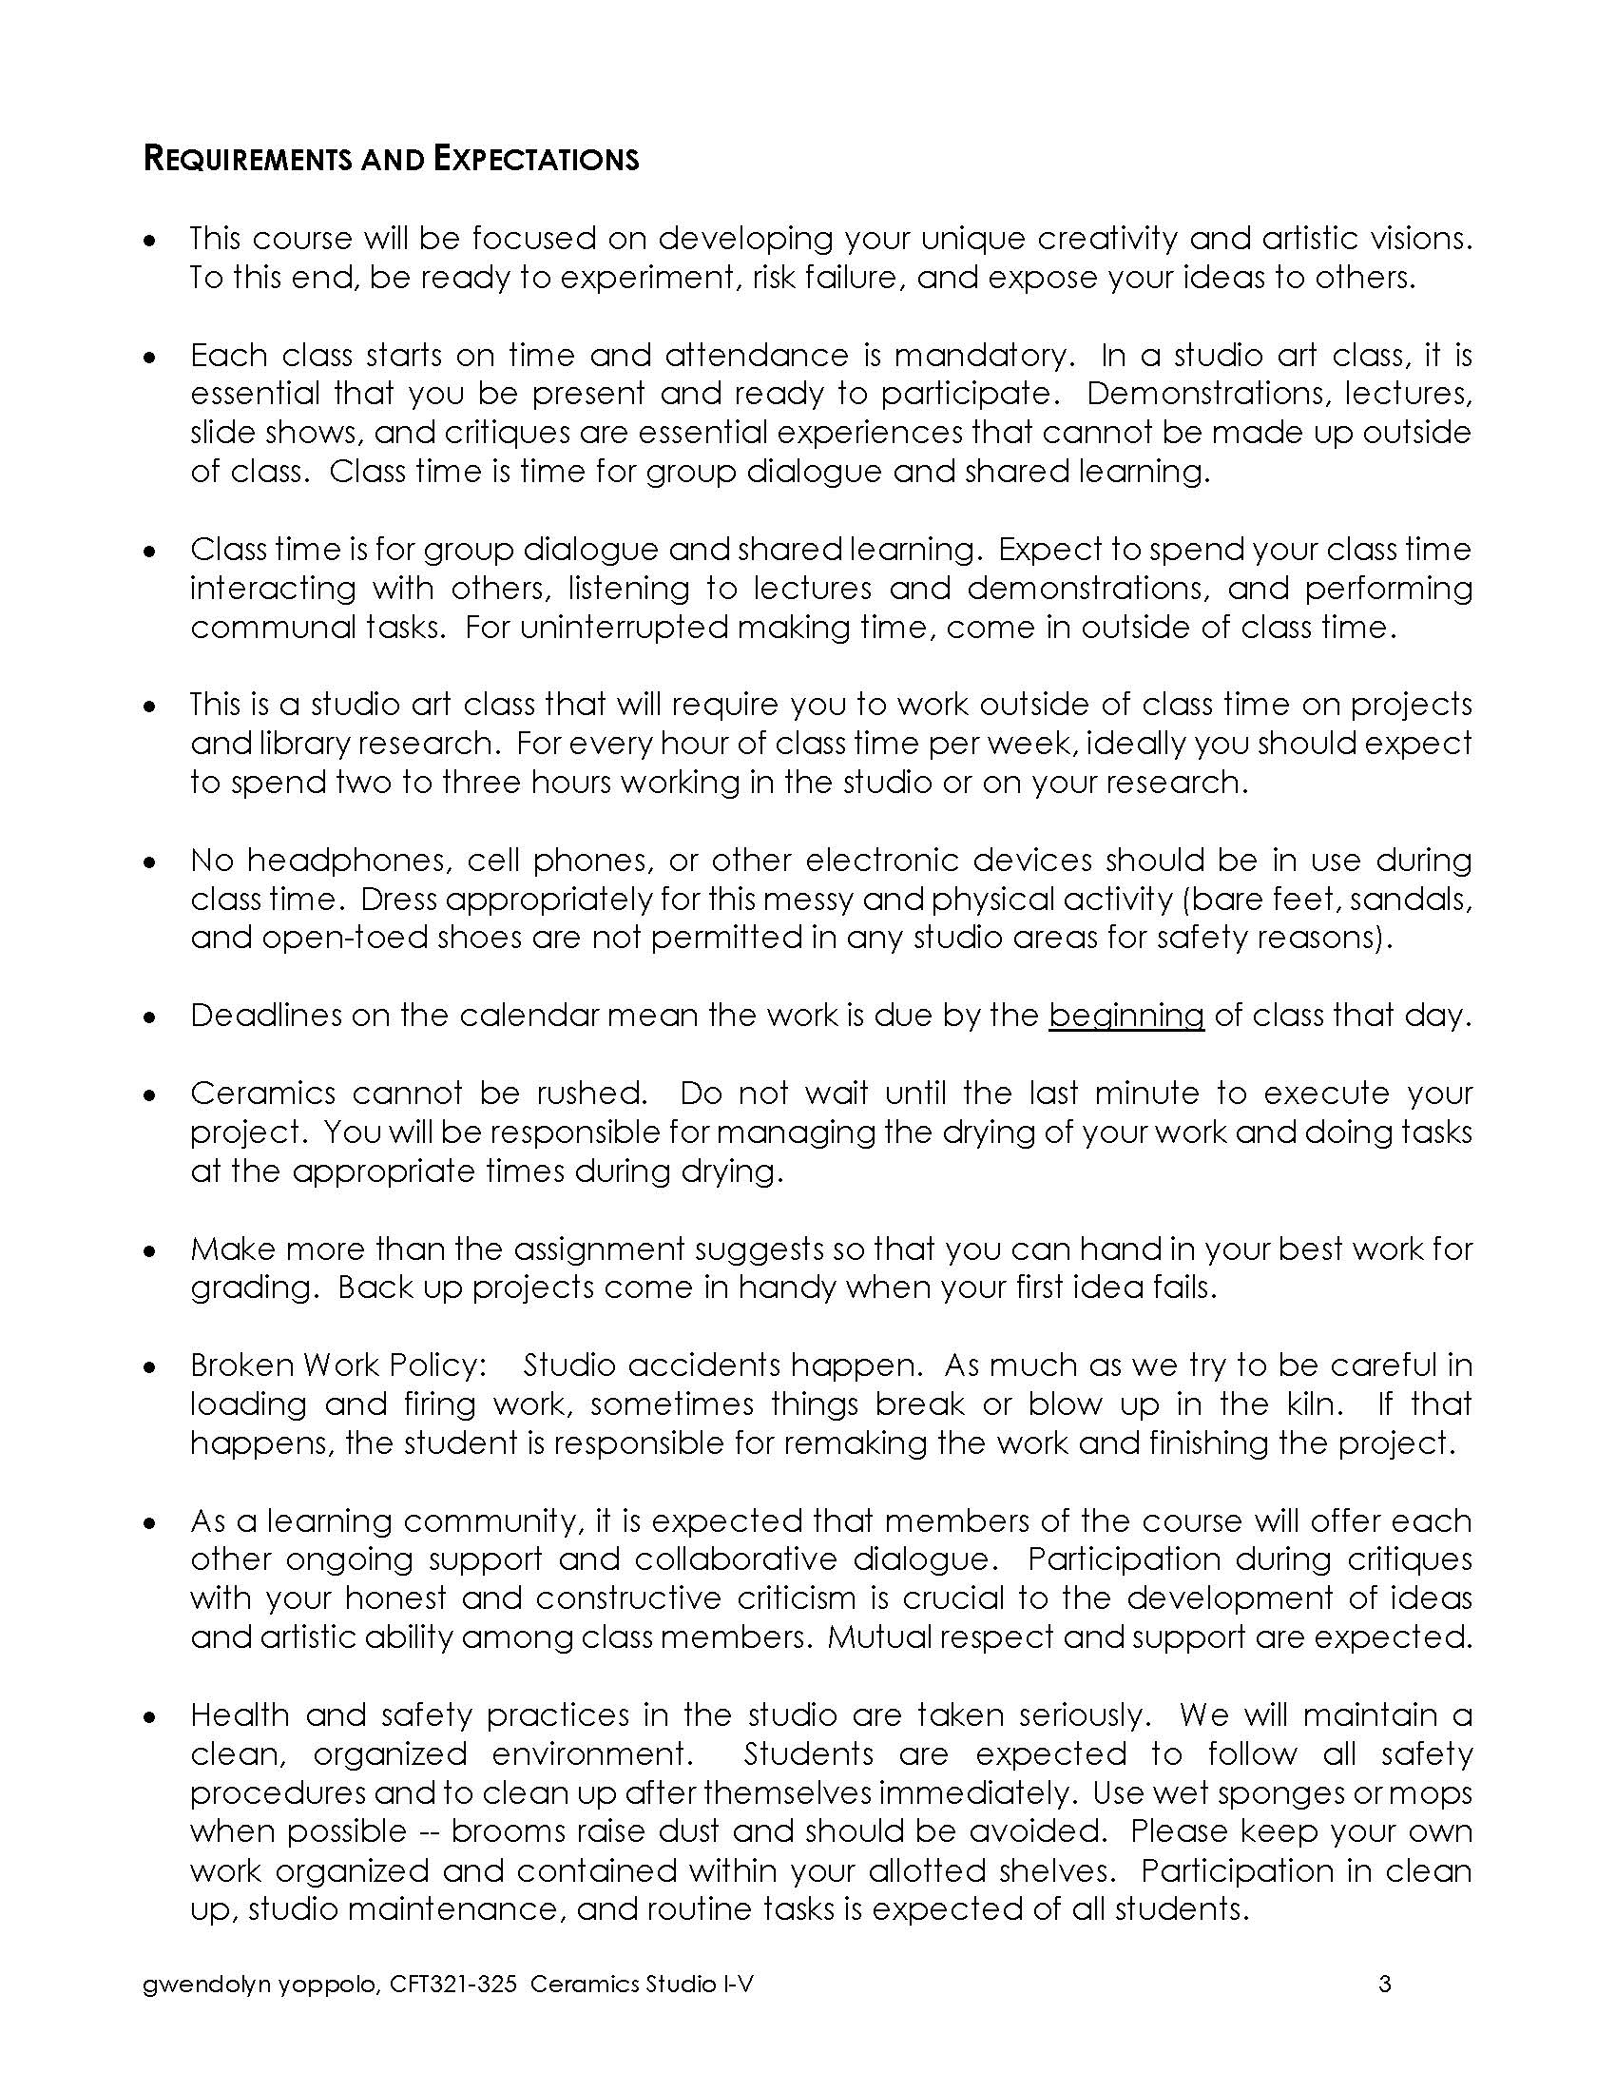
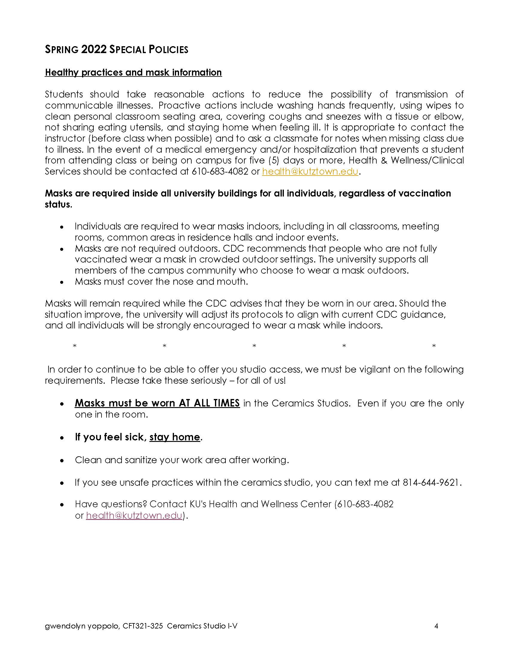
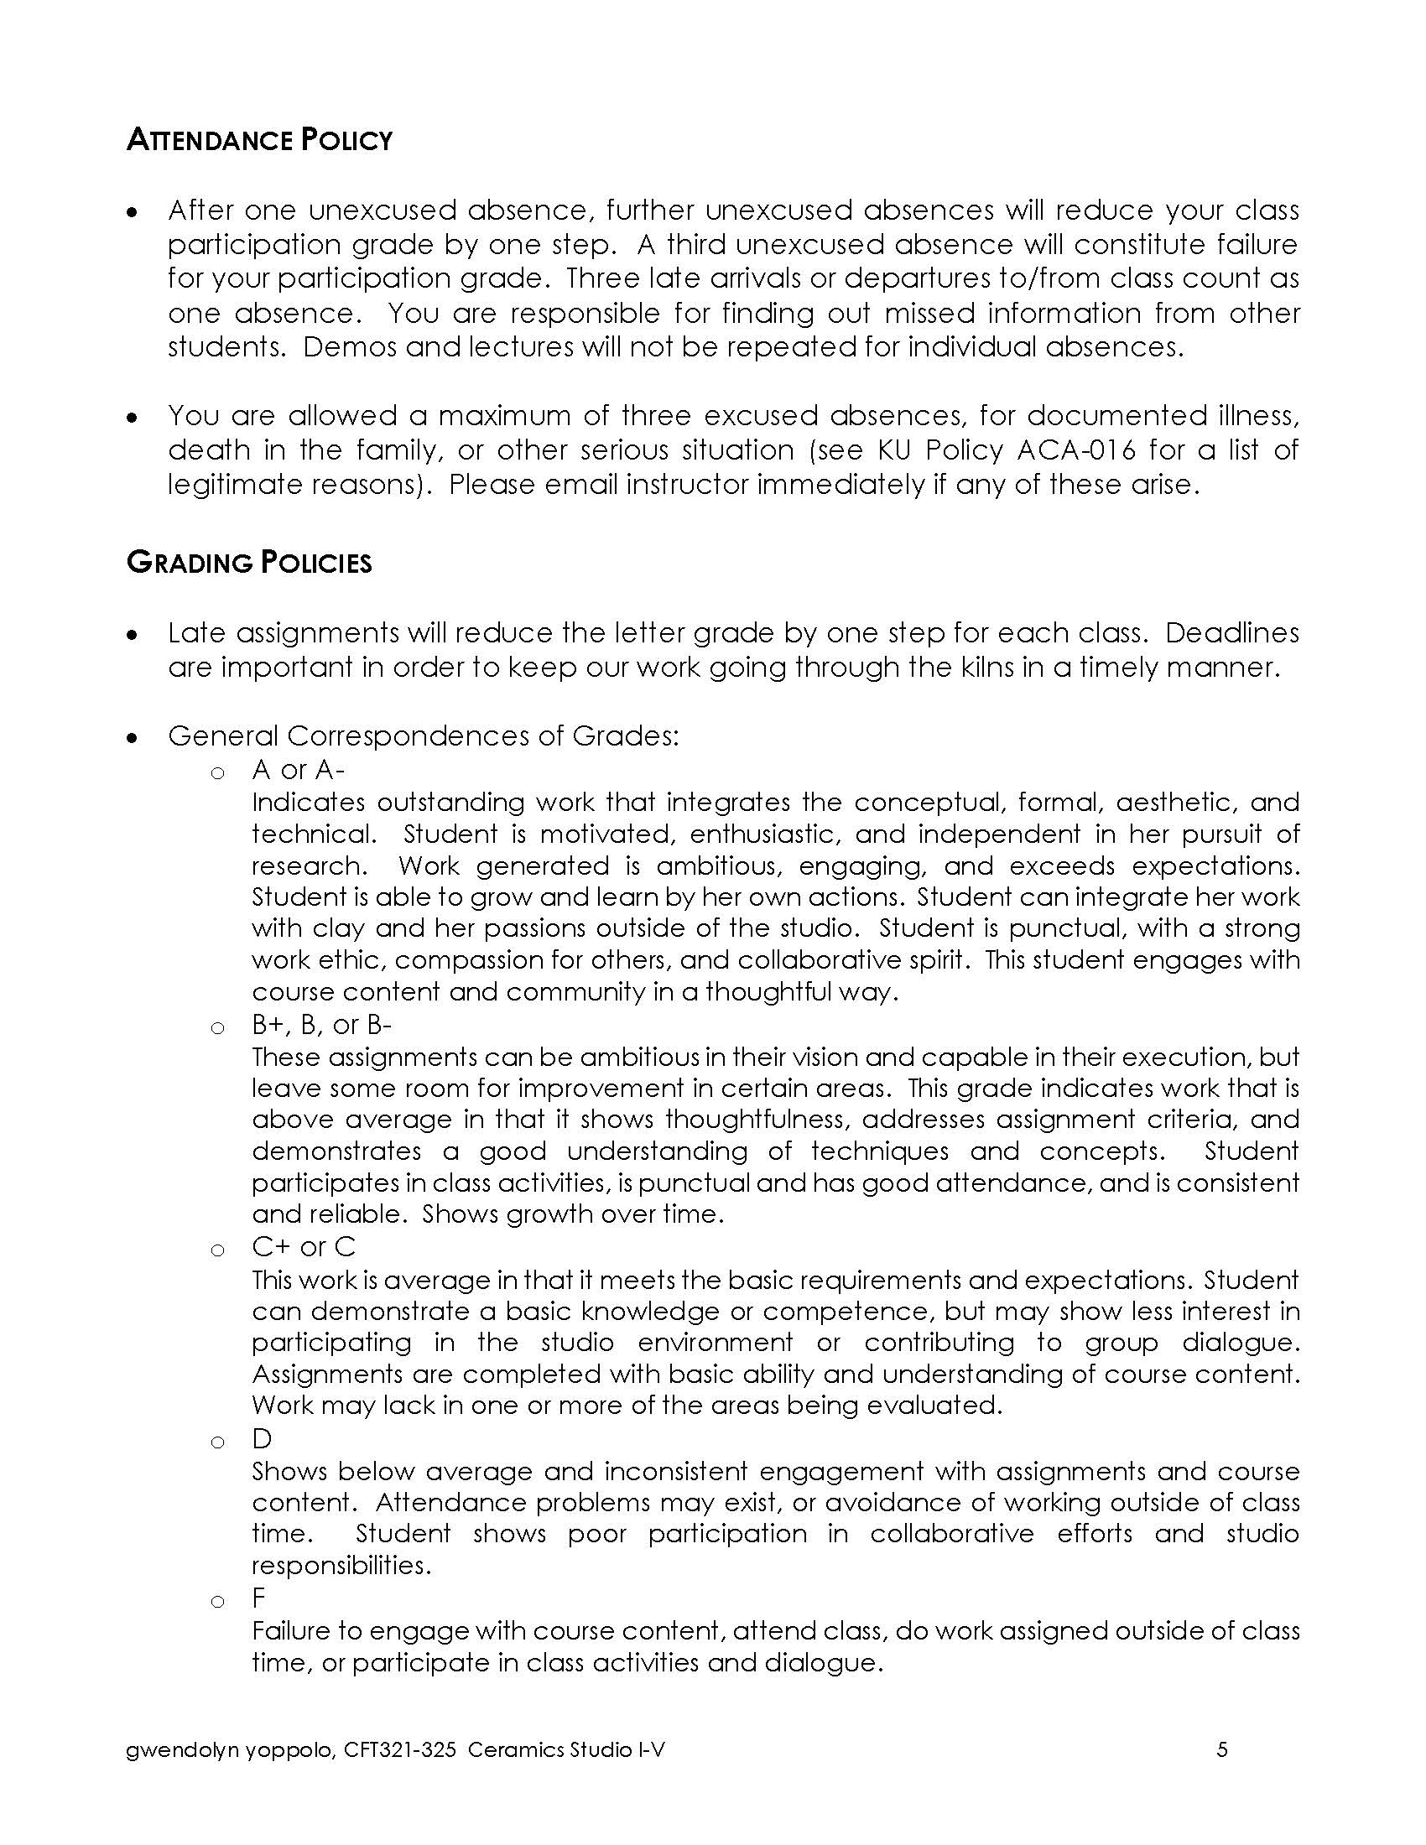
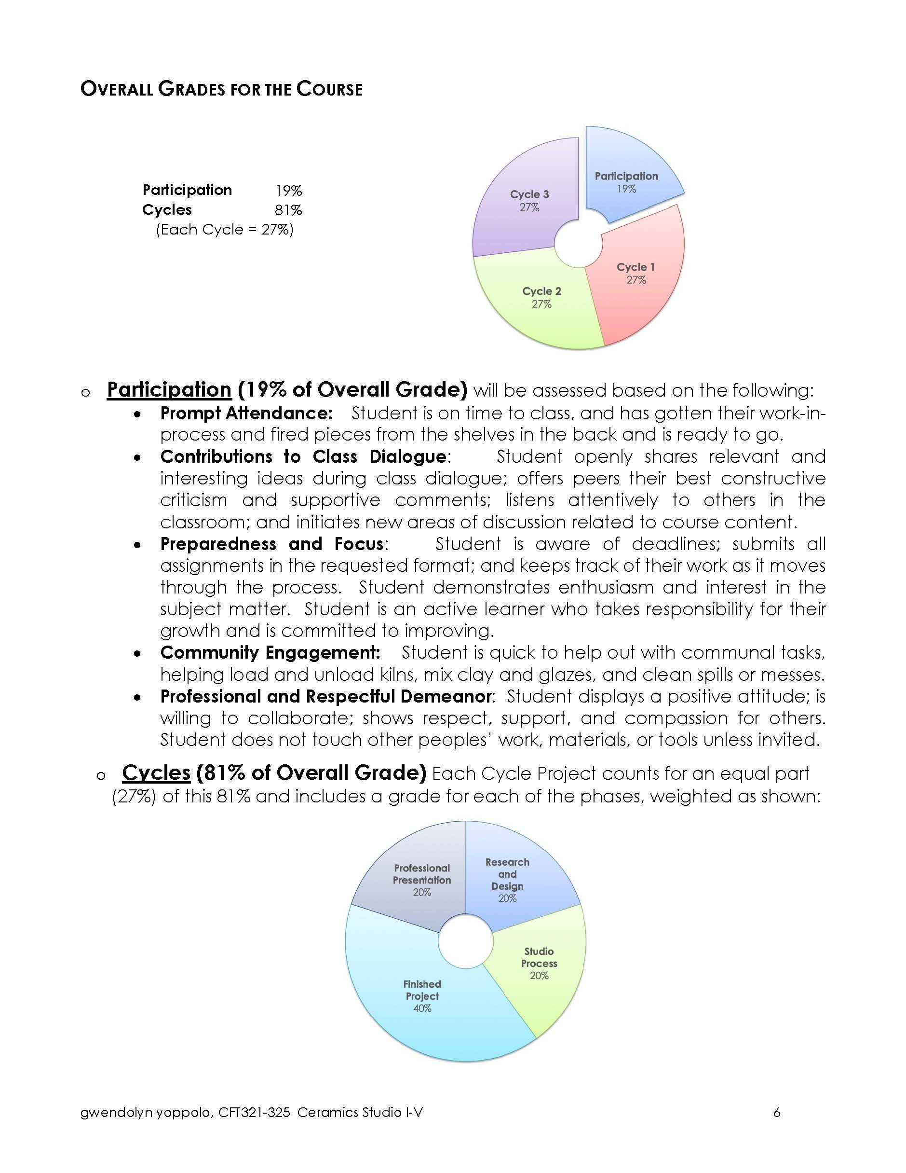
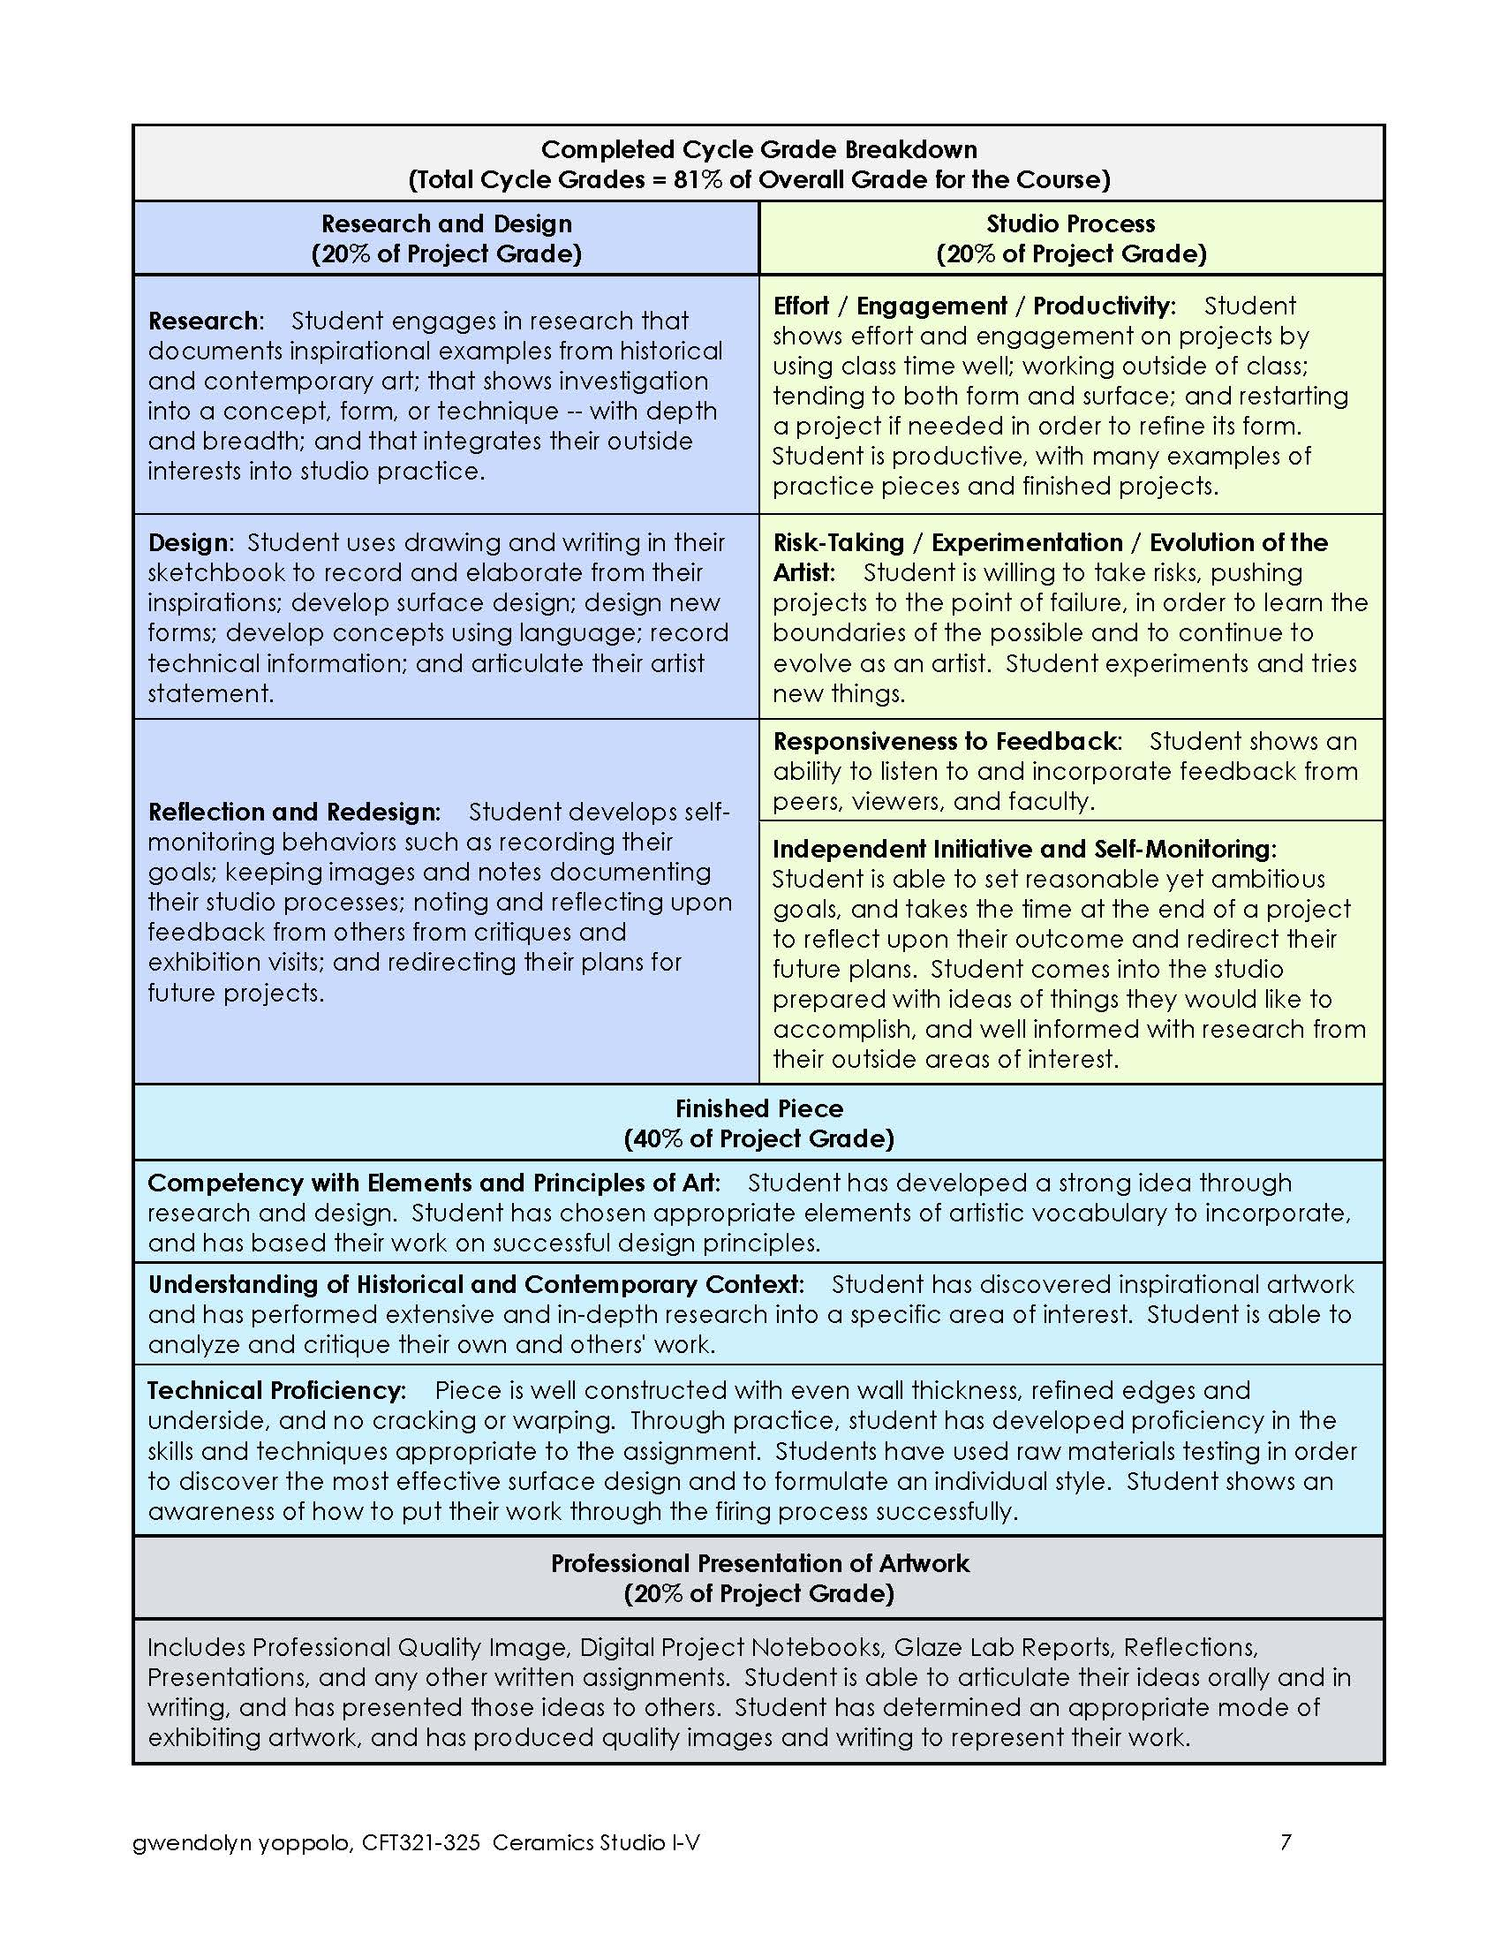
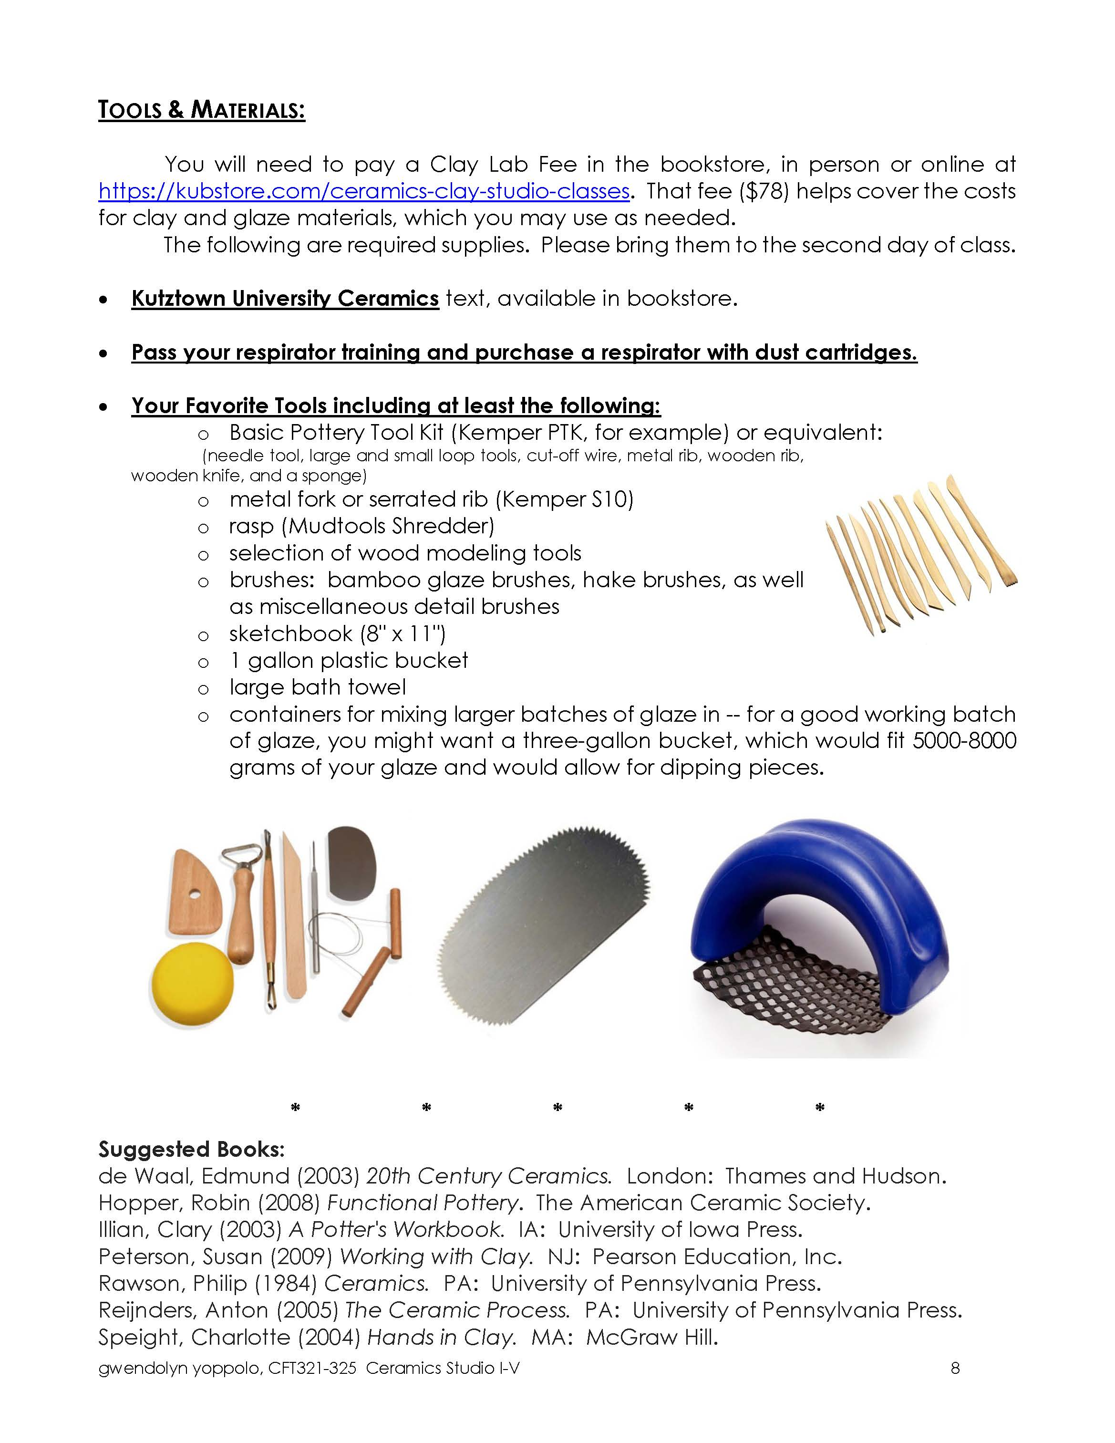
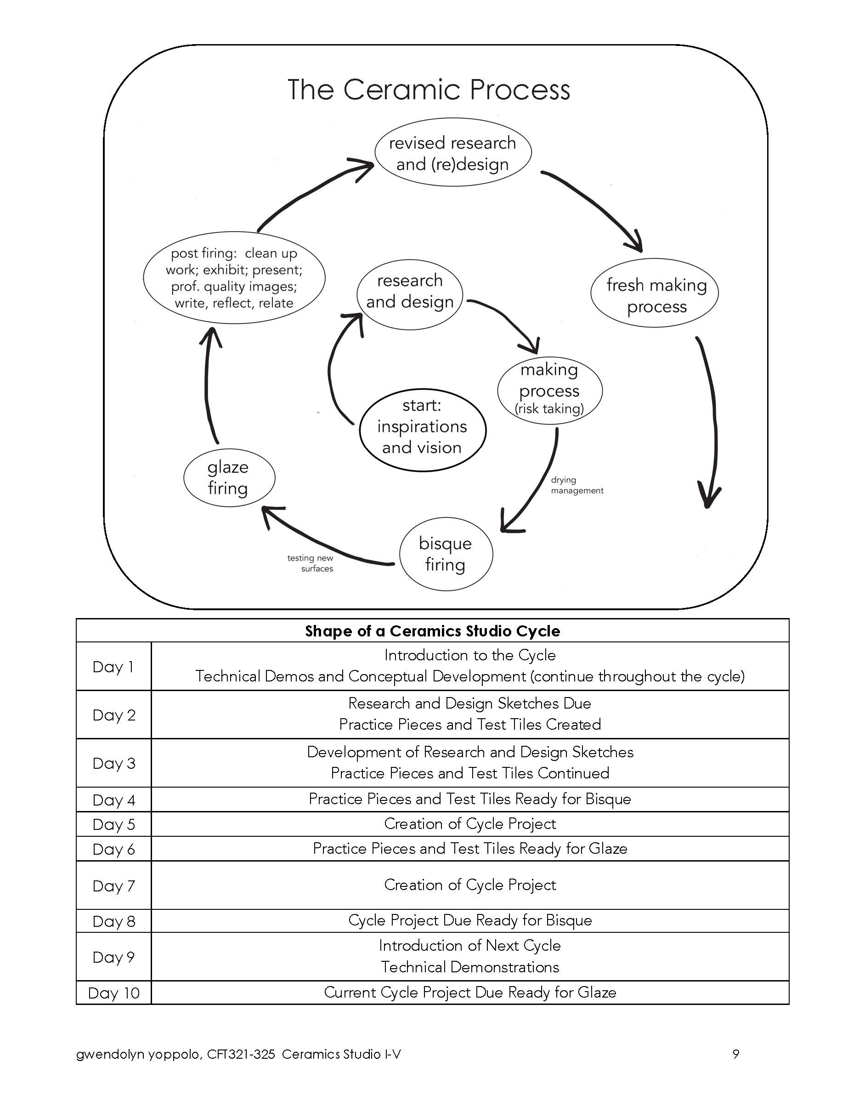
The Syllabus Few People Would Read

Slide 5

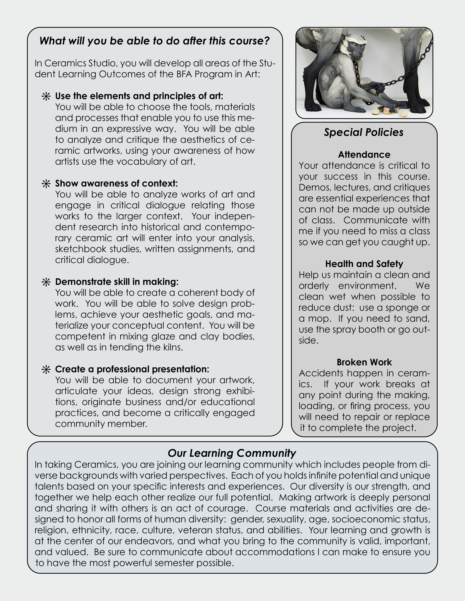
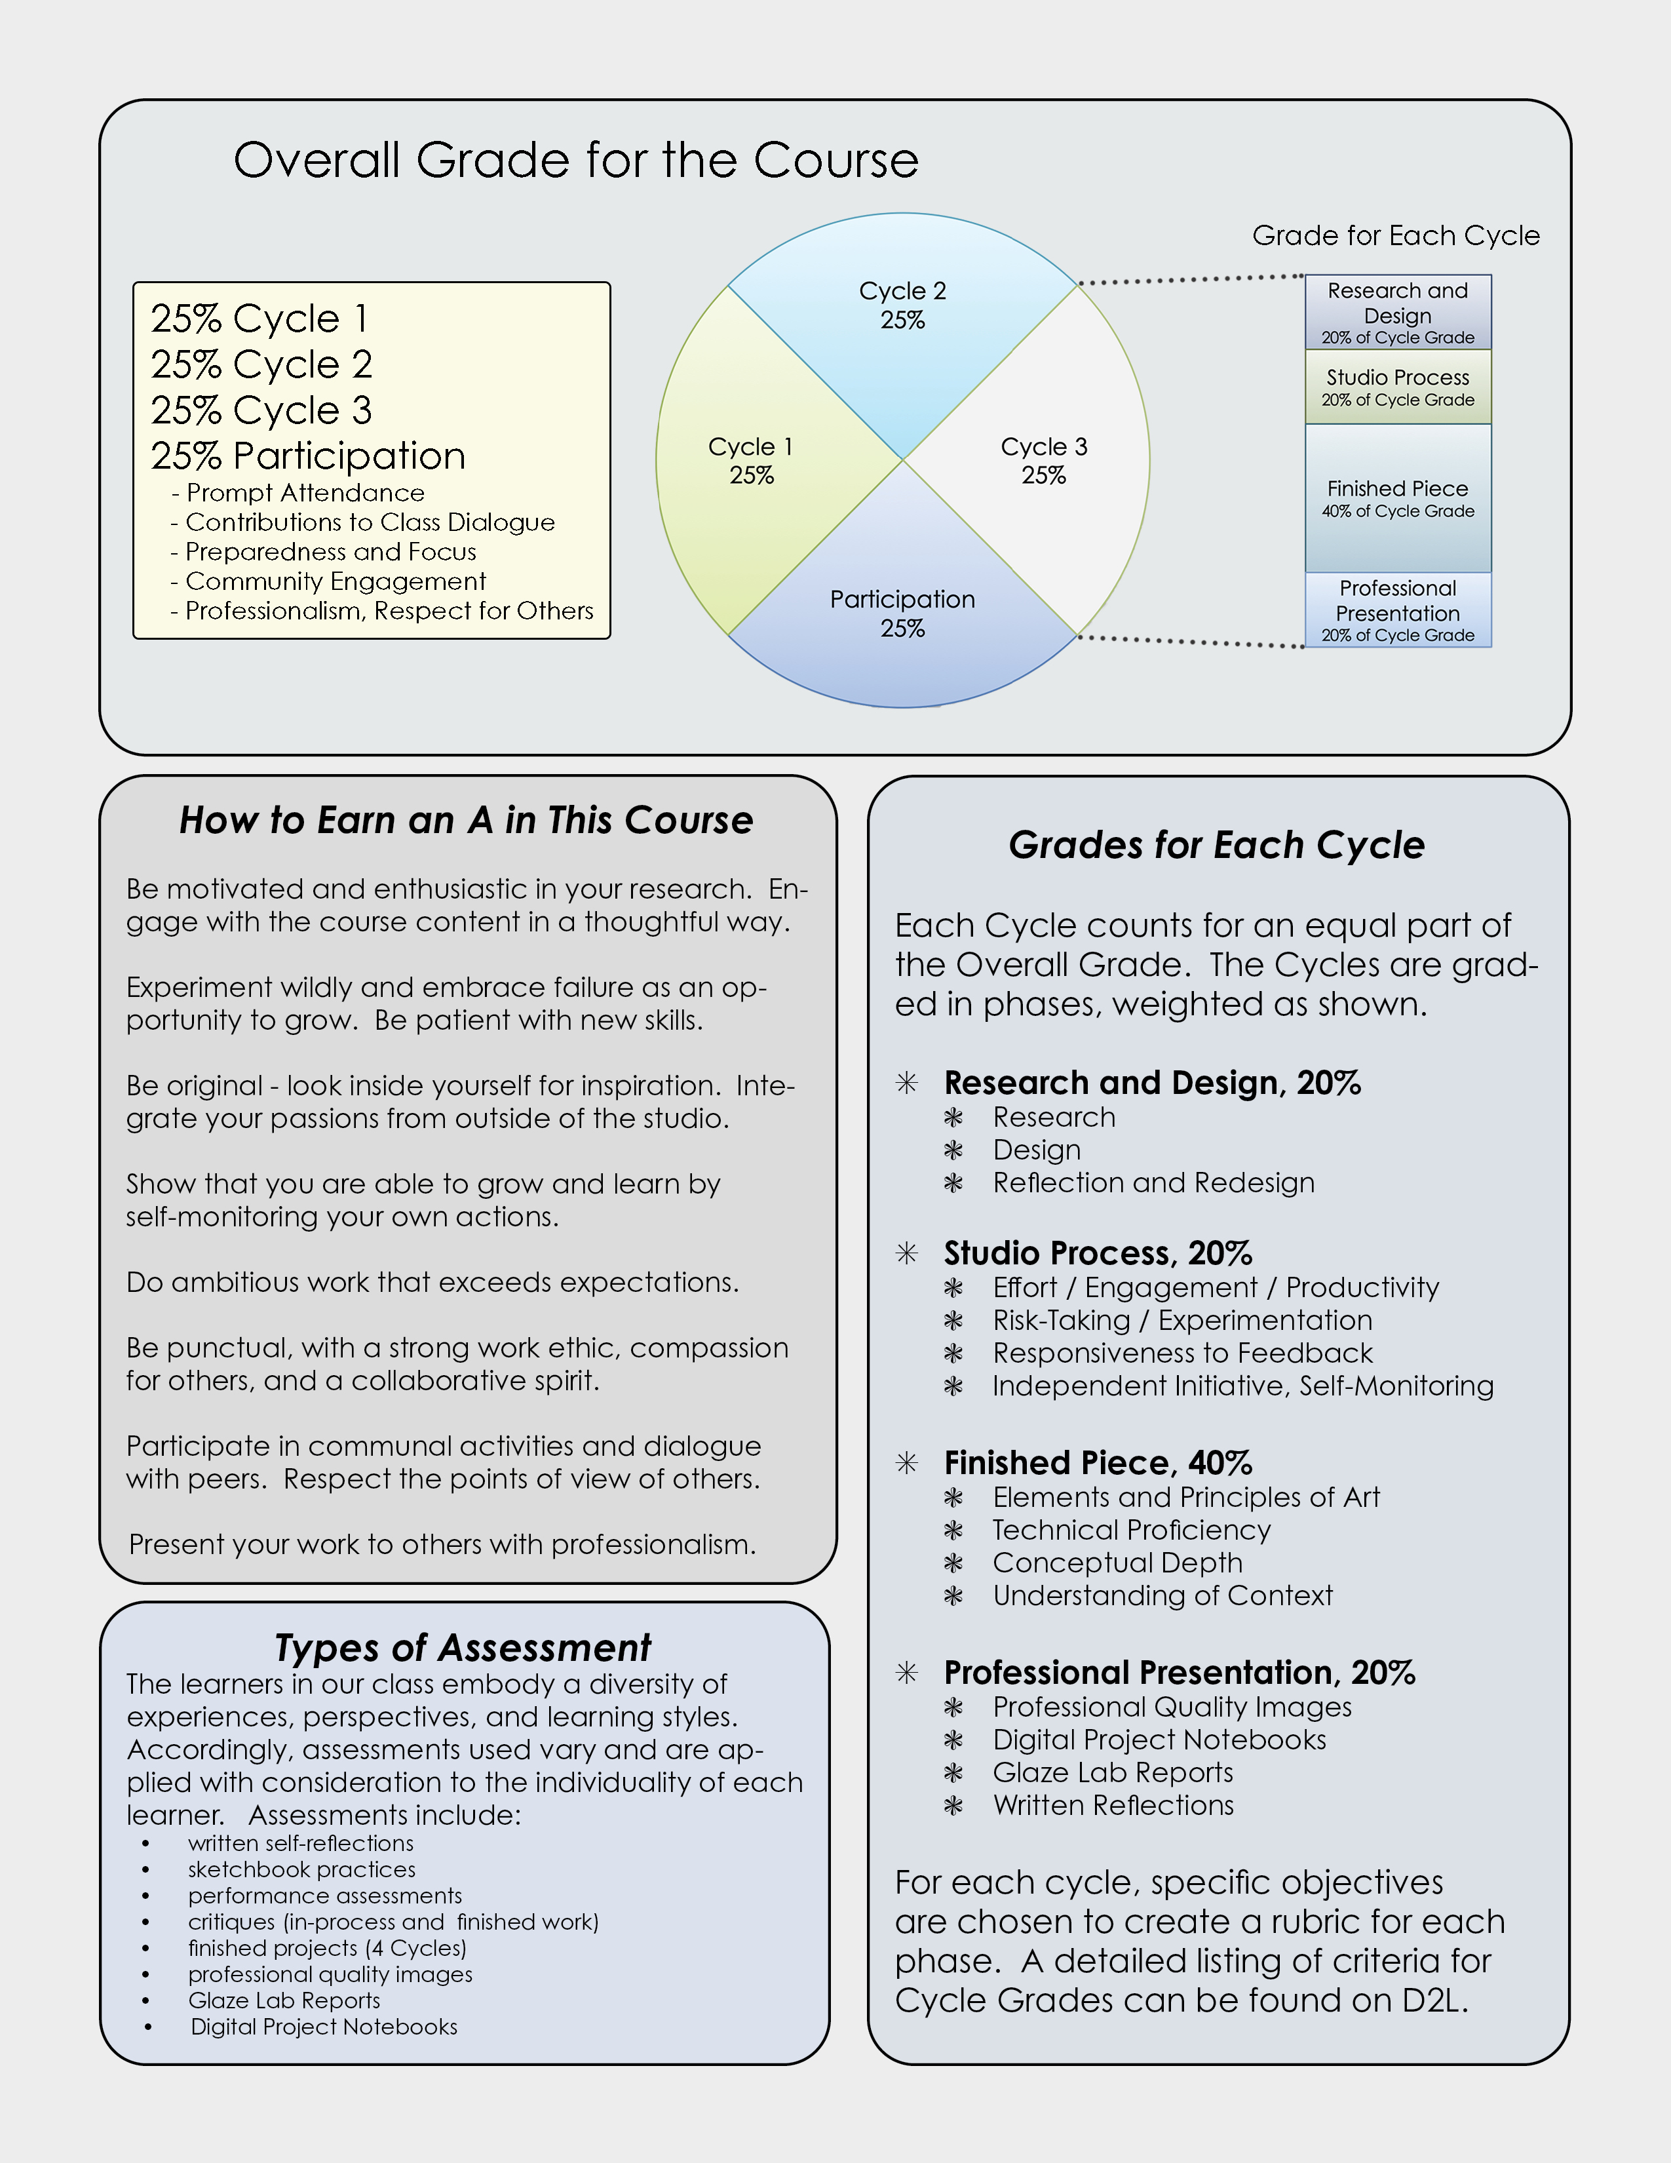
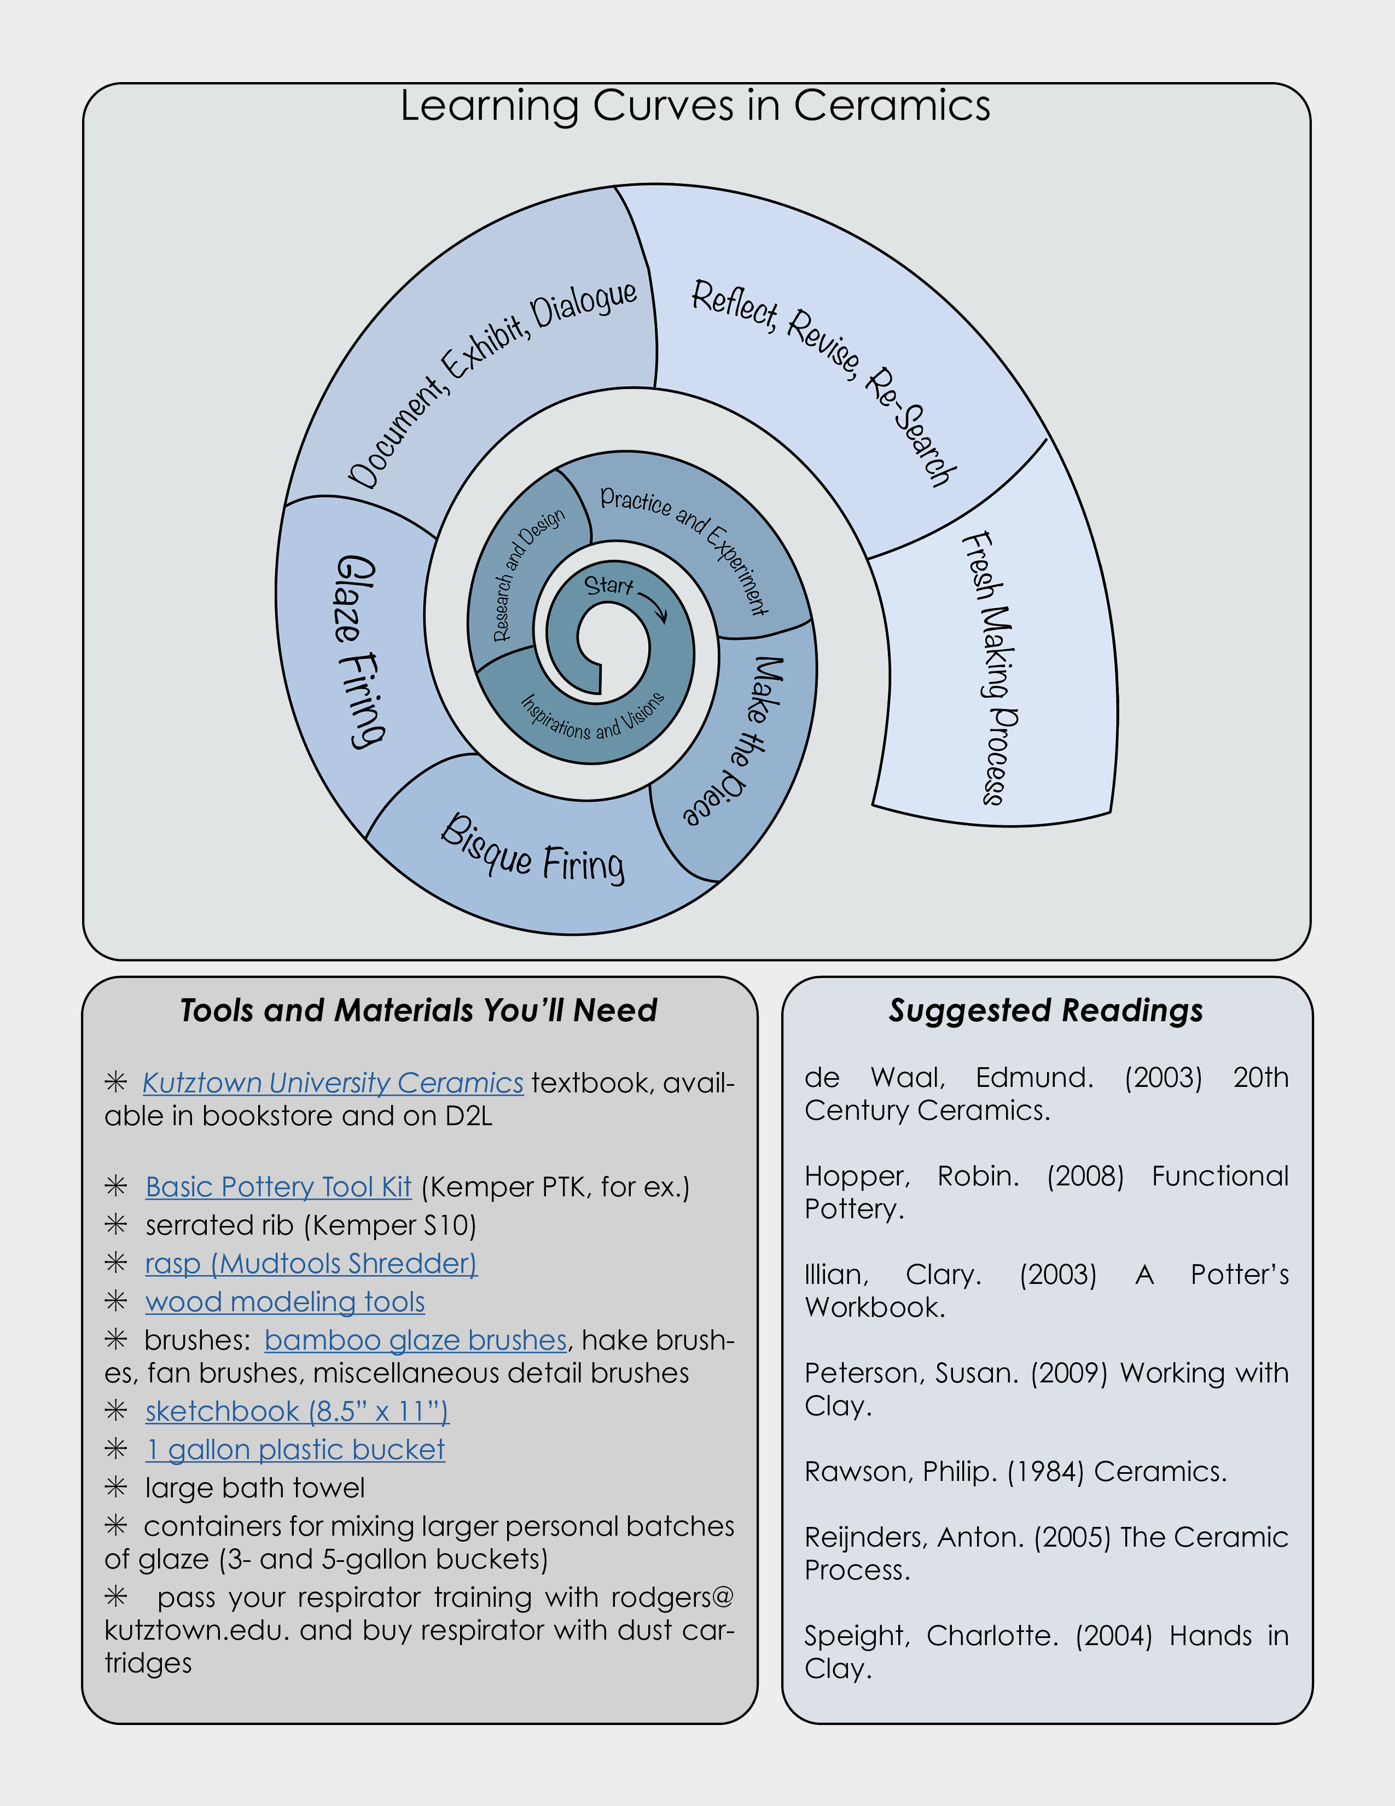
The Syllabus Everyone Wants to Read

Slide 7


Slide 8


Slide 10


Slide 11
Address the students as “you” rather than talking about what some vague “students” will do.

Slide 12
Address the students as “you” rather than talking about what some vague “students” will do.
Talk about active choice-based learning and independent inquiry.
/

Slide 13
Address the students as “you” rather than talking about what some vague “students” will do.
Talk about active choice-based learning and independent inquiry.
/
Use language that shows respect for students as powerful artists.
/

Slide 14
Address the students as “you” rather than talking about what some vague “students” will do.
Spark curiosity and excitement for getting into the studio.
Talk about active choice-based learning and independent inquiry.
/
Use language that shows respect for students as powerful artists.
/

Slide 15
Address the students as “you” rather than talking about what some vague “students” will do.
Spark curiosity and excitement for getting into the studio.
Talk about active choice-based learning and independent inquiry.
/
Use fewer better words!
Use language that shows respect for students as powerful artists.
/

Slide 16
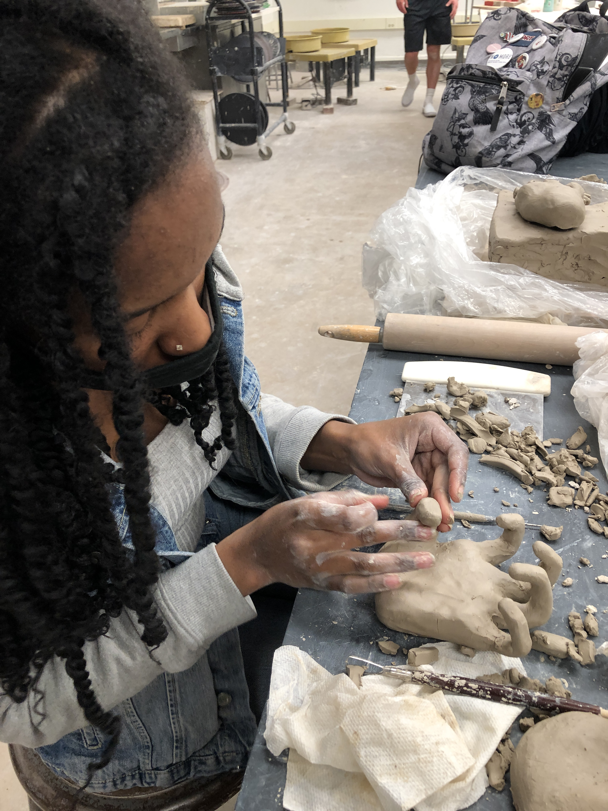
The Biggest Question is
the smallest word: WHY?
Why have I designed the course this way?
Why is studying Ceramics so valuable?
What will they get out of it?

Slide 17
Course Objectives
Check out the Kutztown University Curriculum Committee’s webpage on Writing Course Proposals. It has good suggestions on writing course objectives that are student-centered and measurable, using action words situated on Bloom’s Taxonomy of Educational Objectives to ensure that higher order cognitive processes are engaged. The levels are:
  Knowledge
  Comprehension
  Application
  Analysis
  Synthesis
  Evaluation

Slide 19
Use Fewer and Better Words for Course Objectives:
Accessible Language
Inviting, Motivating Tone
Curiosity-Sparking

Slide 20
Use Fewer and Better Words for Course Objectives:
Accessible Language
Inviting, Motivating Tone
Curiosity-Sparking

Slide 21
Replace Punitive Language with Supportive
Replace Punitive Language with Supportive
Get rid of (or reduce) these
“Requirements and Expectations”

Slide 22
Replace Punitive Language with Supportive
Get rid of (or reduce) these
“Requirements and Expectations”

Slide 23
Replace Punitive Language with Supportive
Reword the Attendance Policy

Slide 24
Inclusion Statement in Plain Language

Slide 27
Behaviors that lead to success in the course are highlighted.

Slide 28
Behaviors that lead to success in the course are highlighted.
Assessments are varied and align to learning objectives.

Slide 29
How to Conceptualize the Learning Process: Why I Call The Units “Cycles”

Slide 30
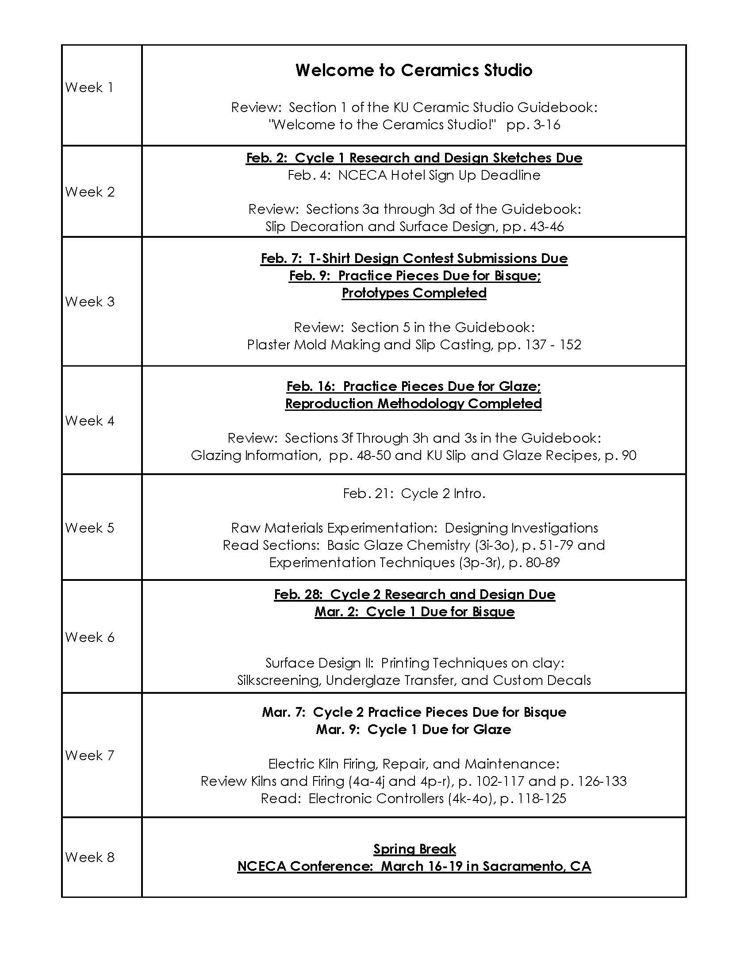
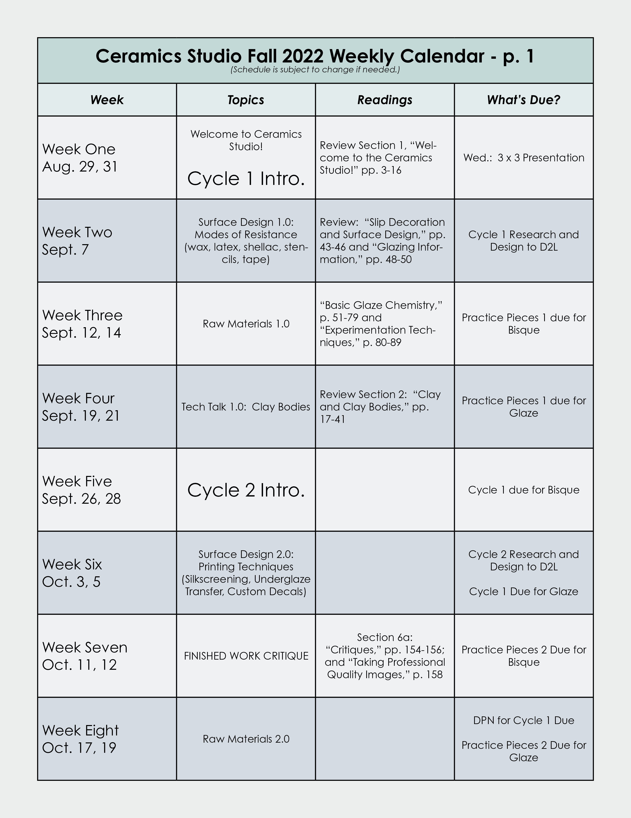

Slide 32
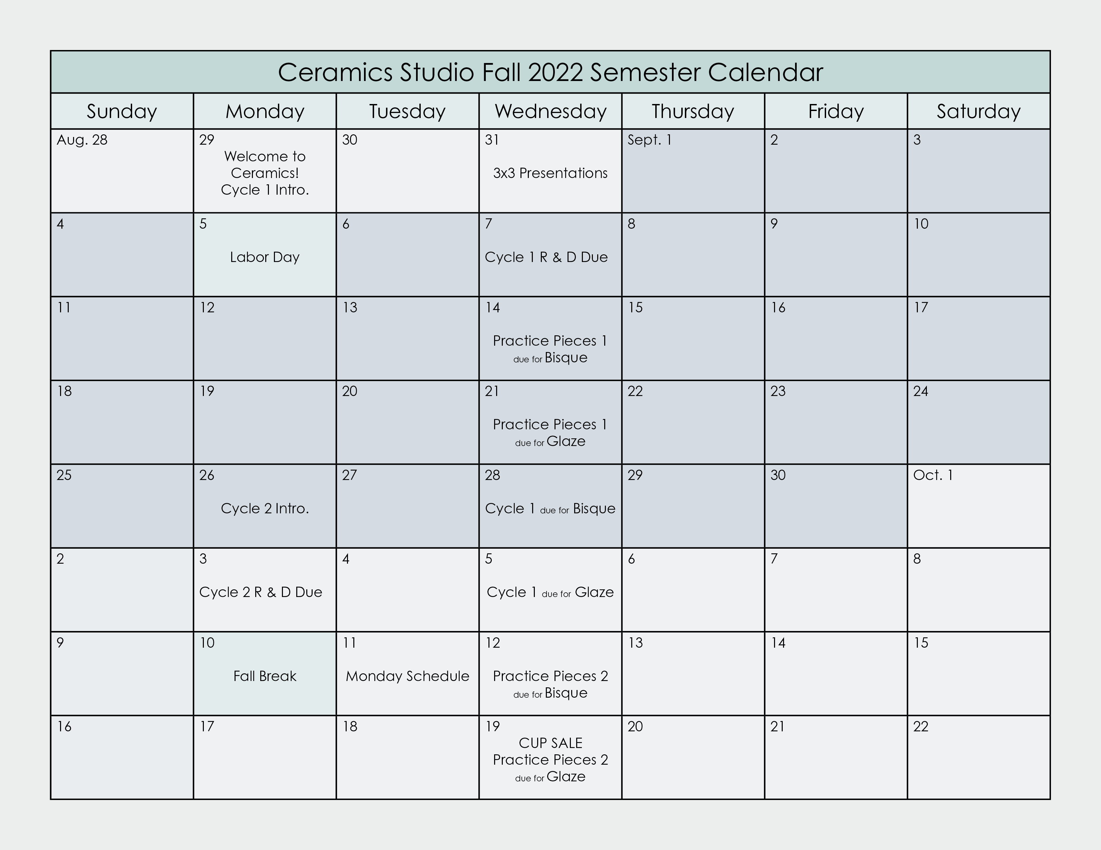

Slide 33
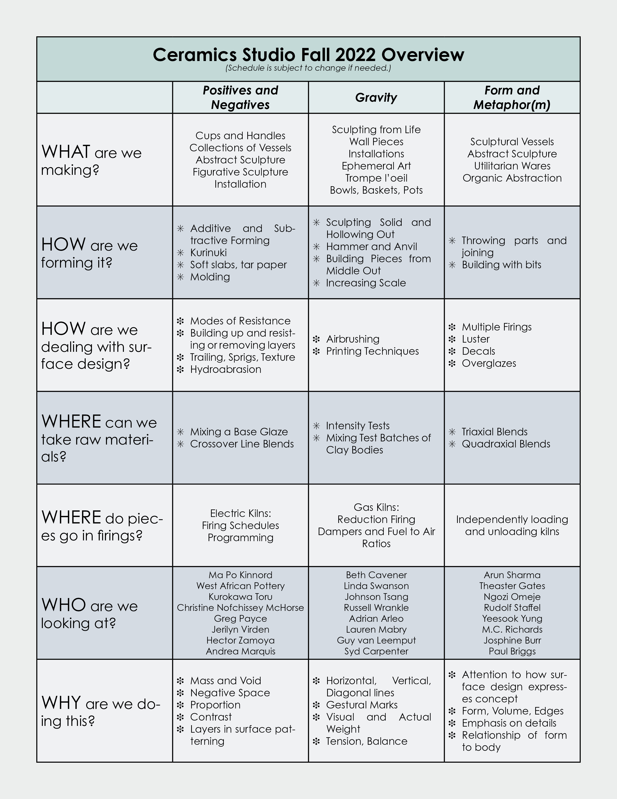
The Overview
Breaks down each cycle
Provides answers to essential questions
Shows students some of their choices
Maps out how cycles are connected to one another and how each cycle serves the learning objectives of the course

Slide 36
Universal Design for Learning: Helpful Links
Universal Design for Learning Universe from the California State University System:
https://enact.sonoma.edu/c.php?g=789377&p=5650604
Center for Universal Design from the NC State University College of Design:
https://design.ncsu.edu/research/center-for-universal-design/
Universal Design for Learning: A Rubric for Evaluating your Course Syllabus:
chrome-extension://oemmndcbldboiebfnladdacbdfmadadm/https://mtsac.libguides.com/ld.php?content_id=27697365
Accessible Syllabus website from Tulane University:
https://www.accessiblesyllabus.com/
Kairos, Suggested Practices for Syllabus Accessibility Statements
https://praxis.technorhetoric.net/tiki-index.php?page=Suggested_Practices_for_Syllabus_Accessibility_Statements
“How to Create a Syllabus,” in The Chronicle of Higher Education:
https://www.chronicle.com/article/how-to-create-a-syllabus/

Slide 37
Student-Centered Syllabus Design: Helpful Links
“The Student-Centered Syllabus,” in The Chronicle of Higher Education:
https://www.chronicle.com/article/the-student-centered-syllabus
“Student Impressions of Syllabus Design: Engaging Versus Contractual Syllabus,” in the ijSOTL:
chrome-extension://oemmndcbldboiebfnladdacbdfmadadm/https://digitalcommons.georgiasouthern.edu/cgi/viewcontent.cgi?referer=&httpsredir=1&article=1634&context=ij-sotl
“Extreme Makeover, Syllabus Edition,” by Tona Hangen:
http://www.tonahangen.com/2011/01/syllabus-makeover/
“Yes, Your Syllabus is Way Too Long,” in The Chronicle of Higher Education:
https://www.chronicle.com/article/yes-your-syllabus-is-way-too-long/
“The Three Essential Functions of your Syllabus,” in The Chronicle of Higher Education:
https://www.chronicle.com/article/the-3-essential-functions-of-your-syllabus-part-1/
https://www.chronicle.com/article/the-3-essential-functions-of-your-syllabus-part-2/
“Your Syllabus Doesn’t Have to Look Like a Contract,” in The Chronicle of Higher Education:
https://www.chronicle.com/article/your-syllabus-doesnt-have-to-look-like-a-contract

Slide 38
Student-Centered Syllabus Design: Helpful Links
“A Learner-centered Syllabus Helps Set the Tone for Learning,” from Faculty Focus:
https://www.facultyfocus.com/articles/effective-classroom-management/a-learner-centered-syllabus-helps-set-the-tone-for-learning/

